Slide 1
Project Life Cycle-Gates
SDLC Stage Gate

Slide 2
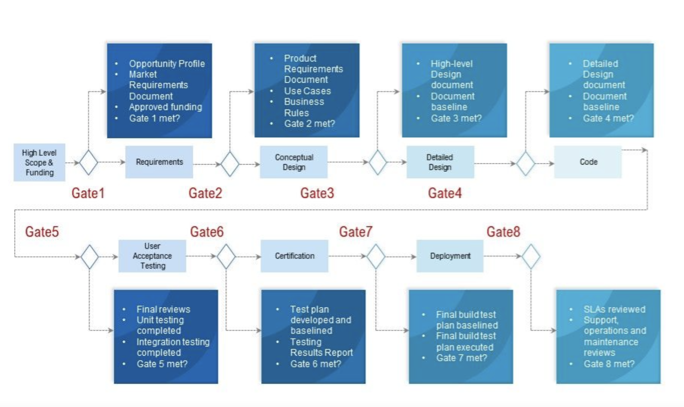
Notes:
Explaining how the project deliverables will be approved or rejected through the phase approval criteria for passing through the stage gates in a project.Here i am, explaining the video how each stage gate and the criteria in each phase to gain approval. Using diagrams provided, created the Microsoft PowerPoint slides to deliver this information in a simulated team meeting.
Here is the project document added with stage gates at each phases, let me walk you through the complete module
Gate1 is the official kickoff of the project - gathering and reviewing the High Level Scope & funding
Gate 2 will be signed off once we complete the Product Requirement Document and reviewed business use cases + Rules
Gate 3 is met when high level design document is signed off
Gate 4 is checked when detailed design document and baseline document is reviewed and signed off
Now coming to Gate 5 , at this phase, the team would have started the development activities and the codecommit are in reviews, so which means Gate 5 is signed off when unit testing is completed and code is merged.
Gate -6 is covering the test plan and analysing the test results and retesting all the defects raised
Gate -7 is checked when the final build test is executed and ready to deploy in production
And now we closed Gate-8 once Stakeholder reviewed the complete project and approve to close it

